Slide 1
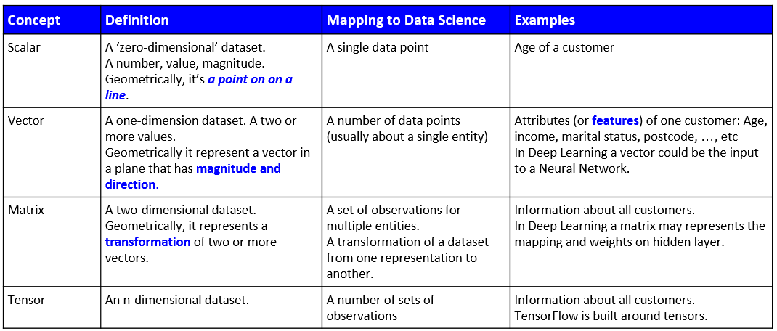
Supplementary materials for Maths Module
Linear Algebra Overview:
Notes:
Dataset has been merged with another report to include more data and can potentially open up more possibilities for analysis and models.
Anxious to see a practical example of how skills learnt on the course can be of value in the business world!
Note that some data columns are repeating and hold the same values as a result:
CompliantUntil and ExpiryDate (same data from different reports)
"Insurance/Accreditation Type" and "ComplianceType" (same data from different reports)
“ProfileId” is the replacement to “SupplierID” - unique identifier for each supplier company
I had some ideas involving measures of project delivery capability against insurance expiry for companies (given most of them expire in June) Also, perhaps some kind of model that predicts project delivery capability, but not sure what data I need for that? Trying to get some indication of how any suitably produced model can help the business?
>For the duplicate columns, you would drop one of them if you are 100% sure they are duplicated
>For the Value column there is a mix of float and text. To be able to do any prediction on this column you would need to clean it up.
>If you wanted to use it for your capstone project for prediction could you get at least 5000-10000

Slide 2
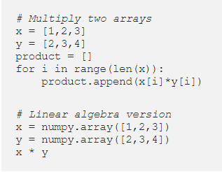
Linear algebra
Linear algebra is a mathematical toolbox that offers helpful techniques for manipulating groups of numbers simultaneously
It turns complicated problems into simple, intuitive, efficiently calculated problems:
Neural networks store weights in matrices. Linear algebra makes matrix operations fast and easy, especially when training on GPUs.
Towards Data Science article

Slide 3
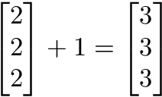
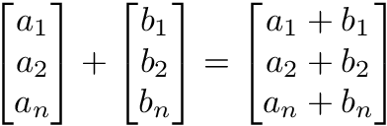
Linear algebra
Scalar operations:
Scalar operations involve a vector and a number. You modify the vector in-place by adding, subtracting, or multiplying the number from all the values in the vector.
Scalar addition Vector addition
Towards Data Science article

Slide 4
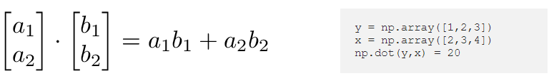
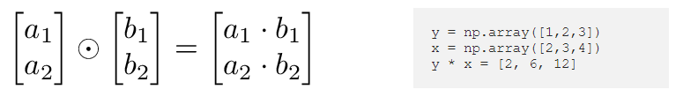
Linear algebra
Dot product:
The dot product of two vectors is a scalar. Dot product of vectors and matrices (matrix multiplication) is one of the most important operations in deep learning.
Hadamard product:
Hadamard Product is elementwise multiplication, and it outputs a vector.

Slide 5
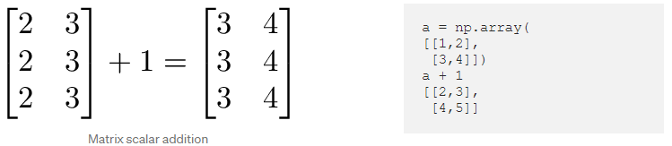
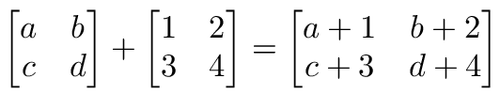
Linear algebra
Matrix scalar operations:
Scalar operations with matrices work the same way as they do for vectors. Simply apply the scalar to every element in the matrix — add, subtract, divide, multiply, etc.
In order to add, subtract, or divide two matrices they must have equal dimensions. We combine corresponding values in an elementwise fashion to produce a new matrix.

Slide 6
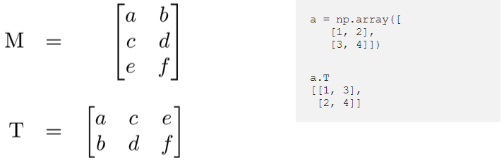
Linear algebra
Matrix transpose
Neural networks frequently process weights and inputs of different sizes where the dimensions do not meet the requirements of matrix multiplication.
Matrix transpose provides a way to “rotate” one of the matrices so that the operation complies with multiplication requirements and can continue. There are two steps to transpose a matrix:
Rotate the matrix right 90°
Reverse the order of elements in each row (e.g. [a b c] becomes [c b a])
As an example, transpose matrix M into T:
Towards Data Science article

Slide 7
Optimisation
Youtube Video:
MIT - Introduction, Optimization Problems
Mathematical Optimization Modeling: Learn the Basics
Mathematical Optimization and Machine Learning
Articles:
An Interactive Tutorial on Numerical Optimization

Slide 8
Connecting Algebra with Neural Networks
Youtube Video:
Vectors, what even are they? | Essence of linear algebra
The Coding Train - 10.9: Neural Networks: Matrix Math Part 3
N.B. Ignore the coding as its in JS (Javascript)
Article:
Data Analysis Method: Mathematics Optimization to Build Decision Making

